Slide 1
CSE 228 – Principles of Artificial Intelligence
Module #3, Lecture #2

Slide 2
Contents
Informed Search:
Greedy Best-First Search
A* Search Algorithm

Slide 3
INFORMED SEARCH / (HEURISTIC SEARCH)
These strategies have additional information about search states, so they can guide the search by ranking successors according to some fitness score until they find a goal state.
Greedy best-first search
A* Search

Slide 4
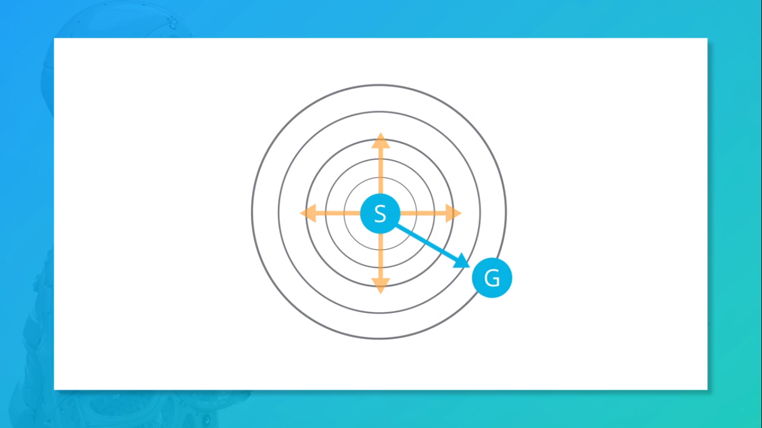

Slide 5


Slide 6
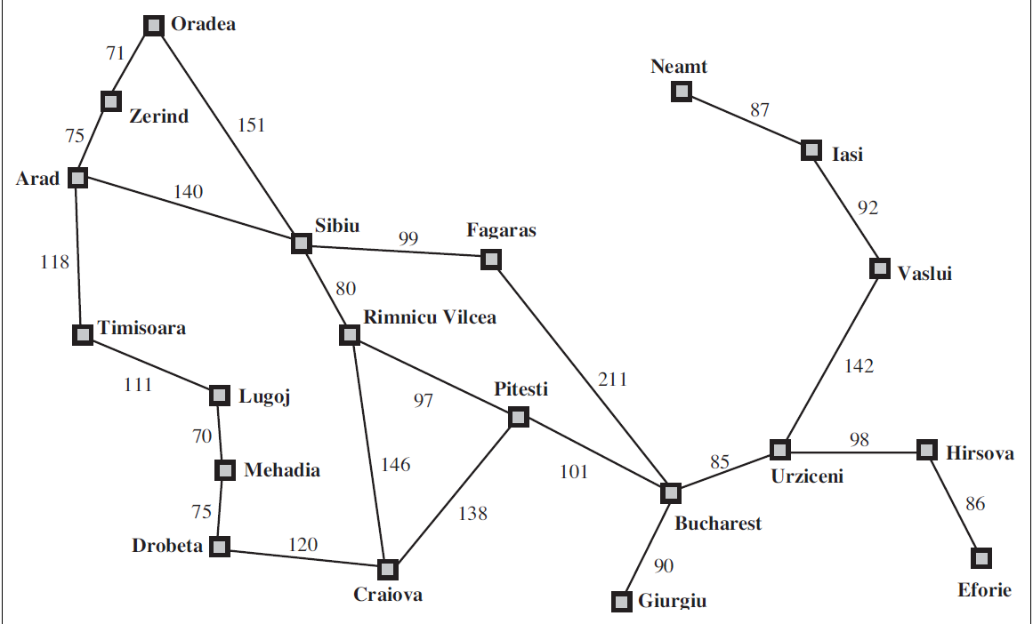
Revisiting the Romanian Navigation Example
City | H-Distance
Arad | 366
Craiova | 160
Drobeta | 242
Fagaras | 176
Lugoj | 244
Mehadia | 241
Oradea | 380
Pitesti | 100
Rimnicu Vilcea | 193
Sibiu | 253
Timisoara | 329
Zerind | 374

Slide 7
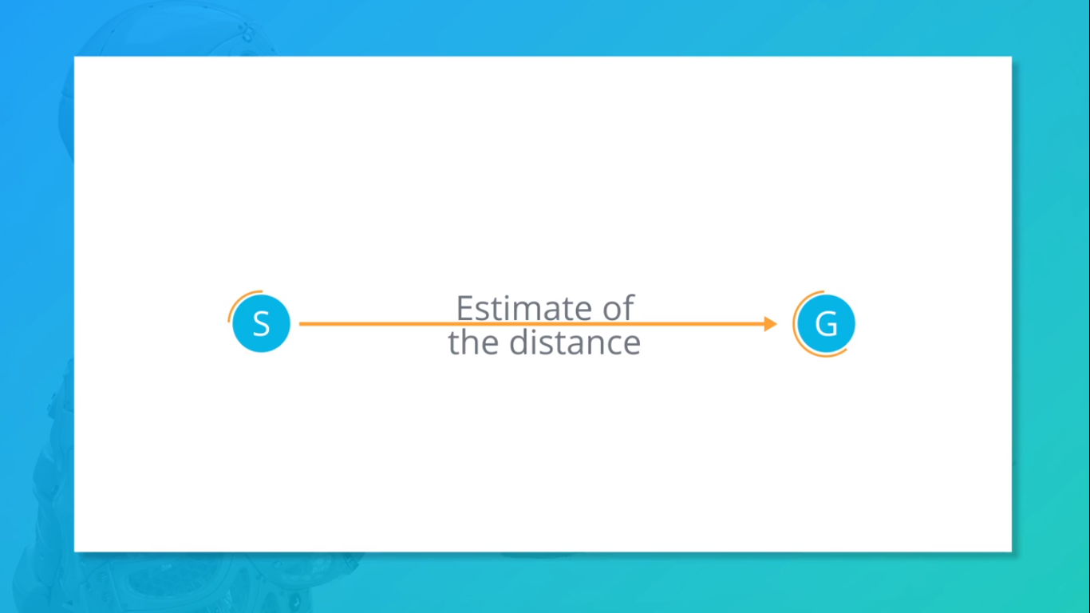

Slide 8
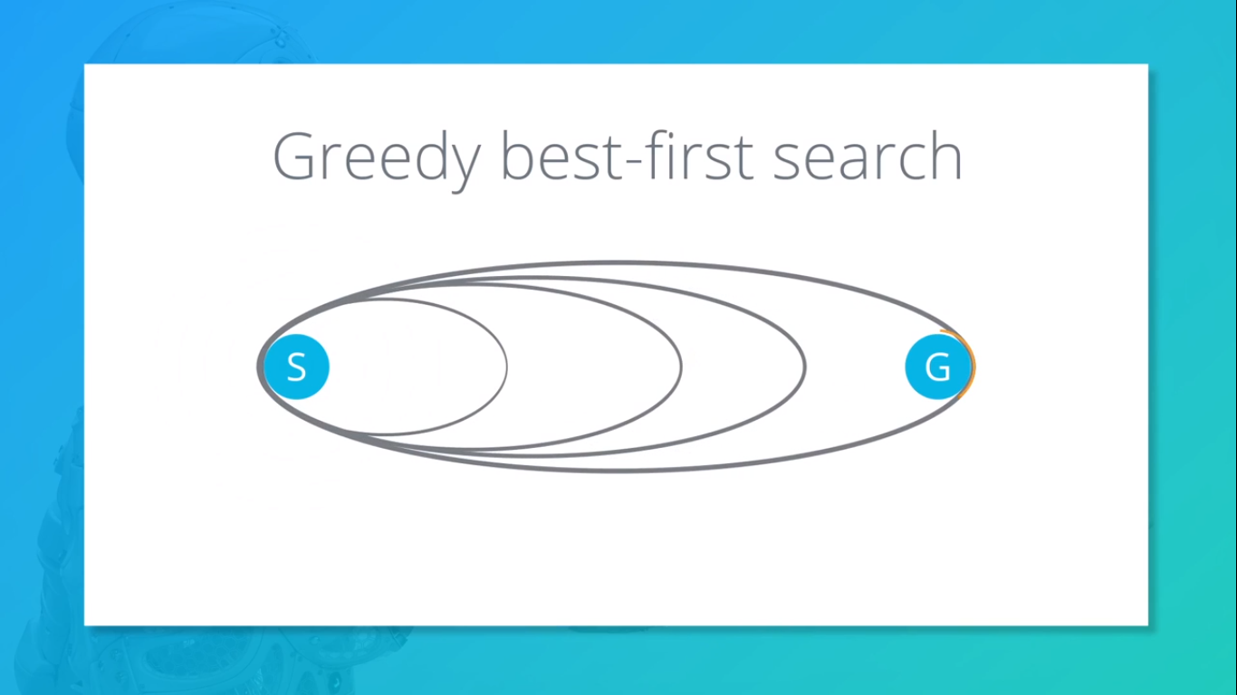

Slide 9
Greedy Best First Search
Mark the start node as visited.
Add the start node to the priority queue
While the priority queue is not empty, do:
Current_node = vertex with least distance to target in the priority queue
Foreach neighbour n of the current_node, do:
If n is not in visited then:
If n is the target node: return n
Else:
Mark n as visited.
Add n to the priority queue.
Return failure

Slide 10
Greedy Best First Search
City | H-Distance
Arad | 366
Craiova | 160
Drobeta | 242
Fagaras | 176
Lugoj | 244
Mehadia | 241
Oradea | 380
Pitesti | 100
Rimnicu Vilcea | 193
Sibiu | 253
Timisoara | 329
Zerind | 374
Mark Arad as visited.
Add Arad to the Queue.
Q = {Arad}

Slide 11
Traversal: Arad
City | H-Distance
Arad | 366
Craiova | 160
Drobeta | 242
Fagaras | 176
Lugoj | 244
Mehadia | 241
Oradea | 380
Pitesti | 100
Rimnicu Vilcea | 193
Sibiu | 253
Timisoara | 329
Zerind | 374
Current Node = Arad, Q = {Arad}
Remove Arad from the Q.
Mark Sibiu, Timisoara and Zerind to the queue.
Add Sibiu, Timisoara and Zerind to the Q.
Q = {Sibiu, Timisoara, Zerind}

Slide 12
Traversal: Arad-> Sibiu
City | H-Distance
Arad | 366
Craiova | 160
Drobeta | 242
Fagaras | 176
Lugoj | 244
Mehadia | 241
Oradea | 380
Pitesti | 100
Rimnicu Vilcea | 193
Sibiu | 253
Timisoara | 329
Zerind | 374
Current Node = Sibiu, Q = {Sibiu, Timisoara, Zerind}
Remove Sibiu from Q.
Mark Fagaras and Rimnicu Vilcea as visited.
Add Fagaras and Rimnicu Vilcea to the Q.
Q = {Fagaras, Rimnicu Vilcea, Timisoara, Zerind}

Slide 13
Traversal: Arad -> Sibiu -> Fagaras
City | H-Distance
Arad | 366
Craiova | 160
Drobeta | 242
Fagaras | 176
Lugoj | 244
Mehadia | 241
Oradea | 380
Pitesti | 100
Rimnicu Vilcea | 193
Sibiu | 253
Timisoara | 329
Zerind | 374
Current Node = Sibiu, Q = {Sibiu, Timisoara, Zerind}
Remove Fagaras from Q.
Mark Bucharest as visited
Add Bucharest to the Queue
Q = {Bucharest, Rimnicu Vilcea, Timisoara, Zerind}
Return Bucharest

Slide 14
Traversal: Arad -> Sibiu -> Fagaras -> Bucharest
Actual Distance = 450
Is it the optimal path?
No.
Arad -> Sibiu -> Rimnicu Vilea -> Pitesti -> Bucharest is more optimal (418)

Slide 15
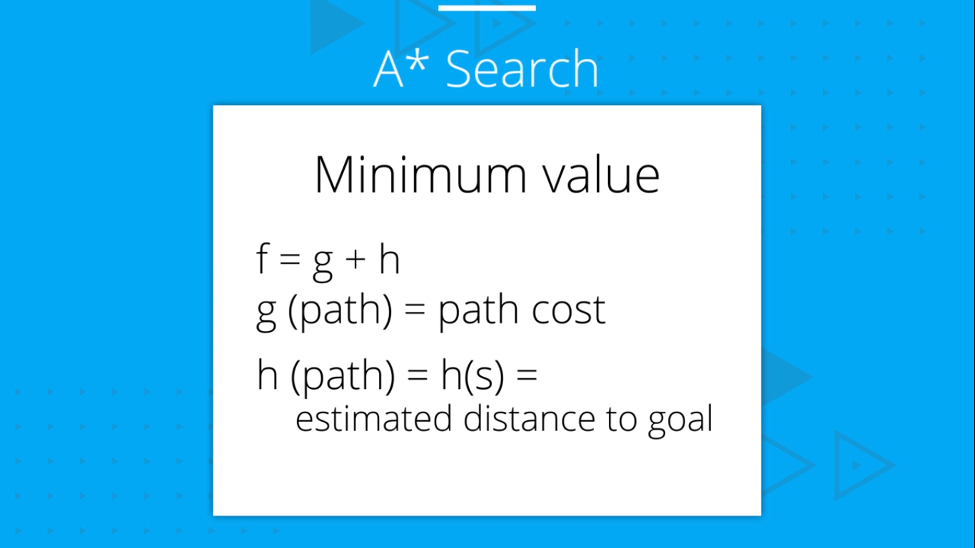
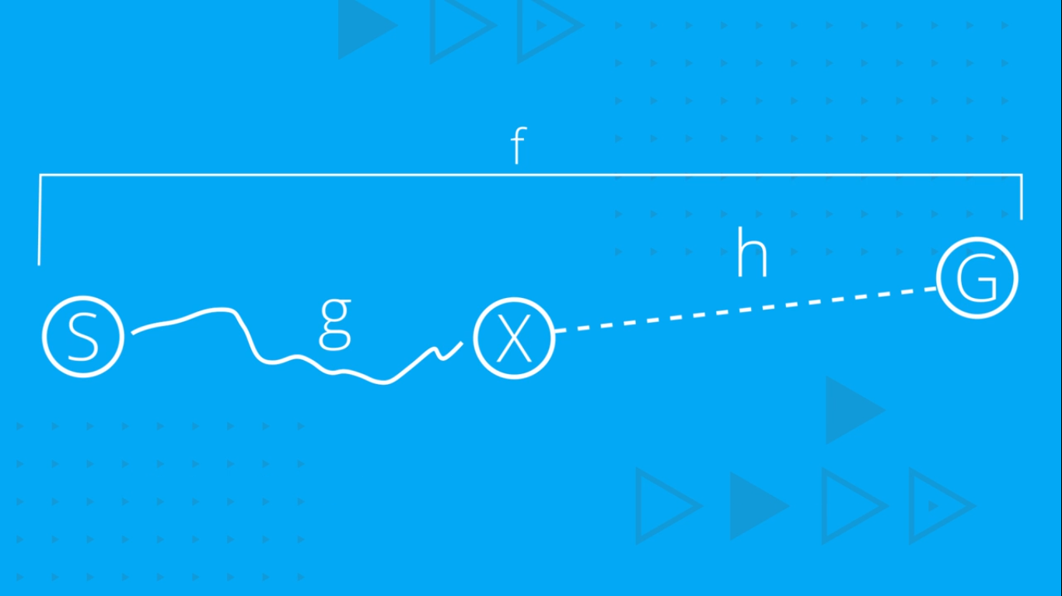

Slide 16
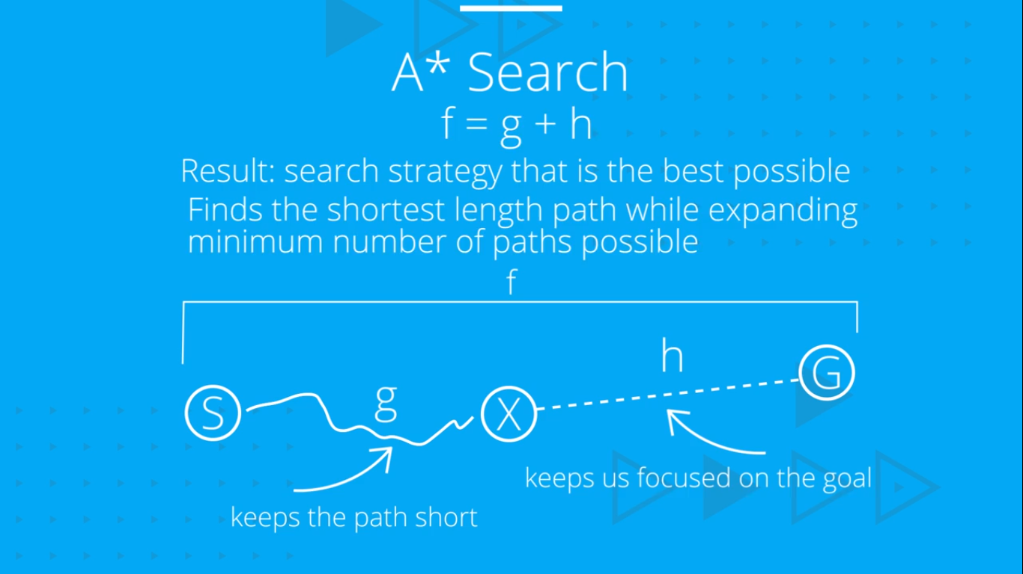
BEST ESTIMATED TOTAL PATH COST FIRST

Slide 17
A* Algorithm
A* Algorithm is one of the best and popular techniques used for path finding and graph traversals.
A lot of games and web-based maps use this algorithm for finding the shortest path efficiently.
It is essentially a best first search algorithm.
Working-
It maintains a tree of paths originating at the start node.
It extends those paths one edge at a time.
It continues until its termination criterion is satisfied.

Slide 18
A* Algorithm extends the path that minimizes the following function-
f(n) = g(n) + h(n)
Here,
‘n’ is the node on the path
g(n) is the cost of the path from start node to node ‘n’
h(n) is a heuristic function that estimates cost of the cheapest path from node ‘n’ to the goal node

Slide 19
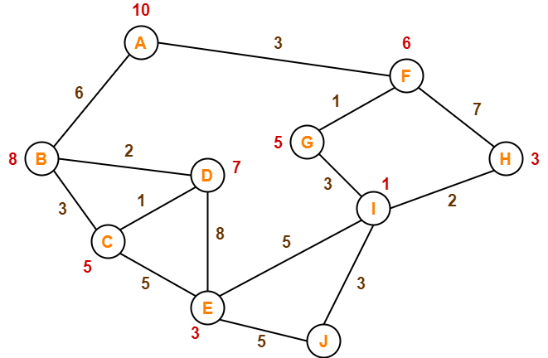
Find the most cost-effective path to reach from start state A to final state J using A* Algorithm

Slide 20
First Iteration. Path = A
We start with node A.
Node B and Node F can be reached from node A.
A* Algorithm calculates f(B) and f(F).
f(B) = 6 + 8 = 14
f(F) = 3 + 6 = 9
Since f(F) < f(B), so it decides to go to node F.
Path = A → F

Slide 21

Second Iteration. Path = A -> F
Node G and Node H can be reached from node F.
A* Algorithm calculates f(G) and f(H).
f(G) = (3+1) + 5 = 9
f(H) = (3+7) + 3 = 13
Since f(G) < f(H), so it decides to go to node G.
Path- A → F → G

Slide 22
Third Iteration. Path = A -> F -> G
Node I can be reached from node G.
A* Algorithm calculates f(I).
f(I) = (3+1+3) + 1 = 8
It decides to go to node I.
Path- A → F → G → I

Slide 23
Final Iteration. Path = A -> F -> G -> I
Node E, Node H and Node J can be reached from node I.
A* Algorithm calculates f(E), f(H) and f(J).
f(E) = (3+1+3+5) + 3 = 15
f(H) = (3+1+3+2) + 3 = 12
f(J) = (3+1+3+3) + 0 = 10
Since f(J) is least, so it decides to go to node J.
Final Path: A → F → G → I → J

Slide 24
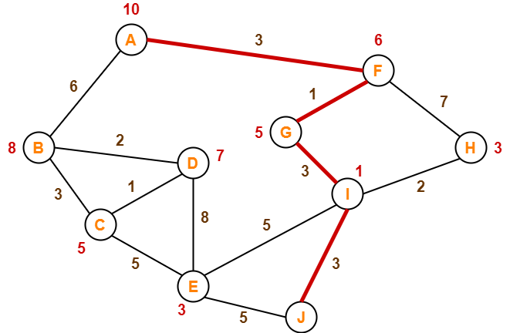
A* Result

Slide 25
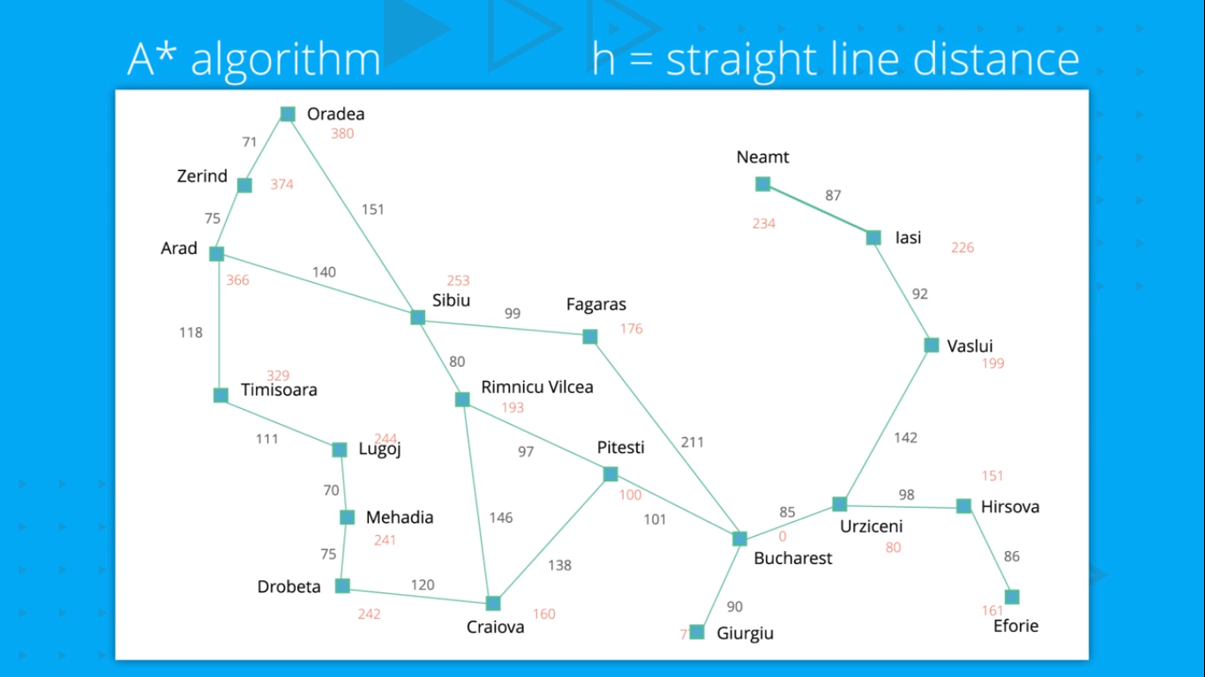

Slide 26
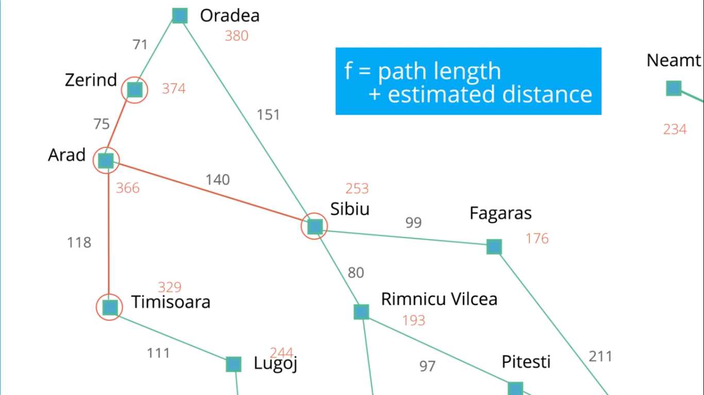

Slide 27
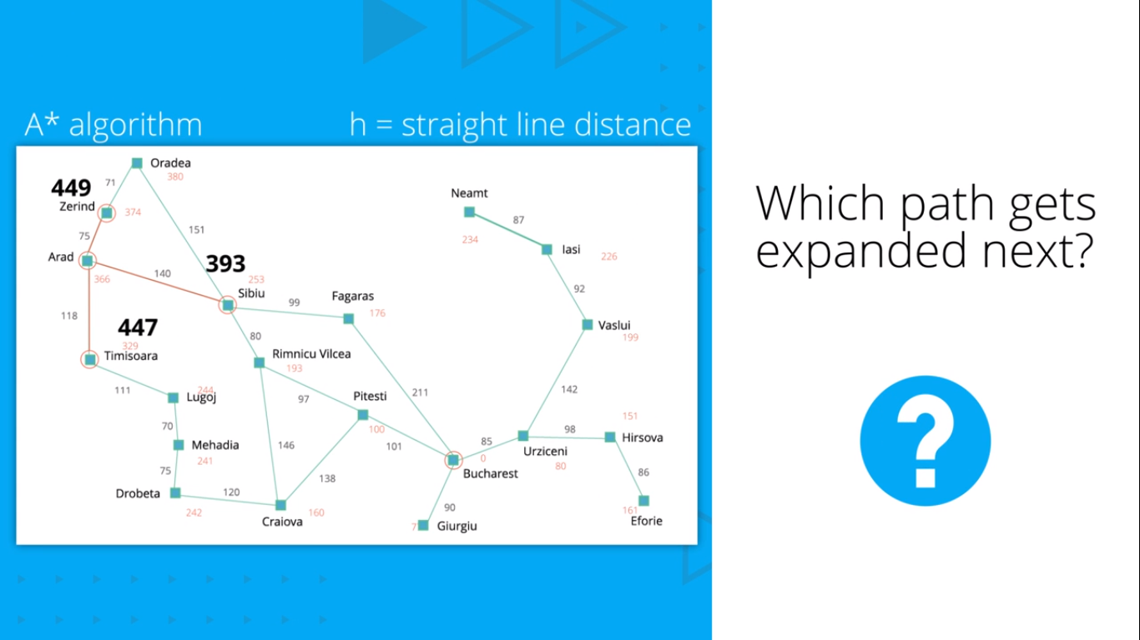
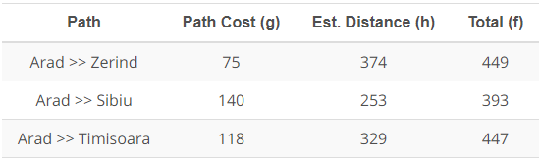

Slide 28

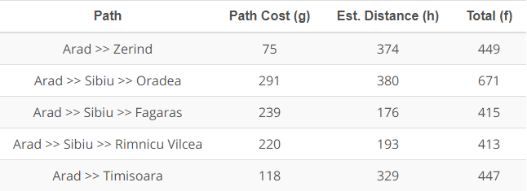

Slide 29

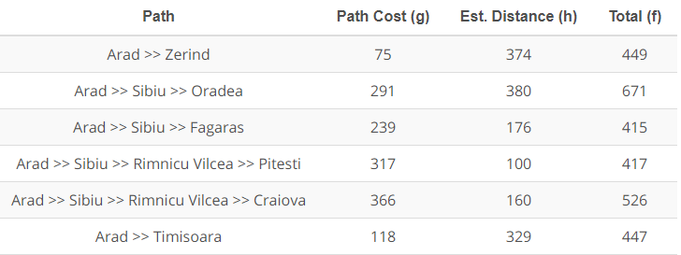

Slide 30
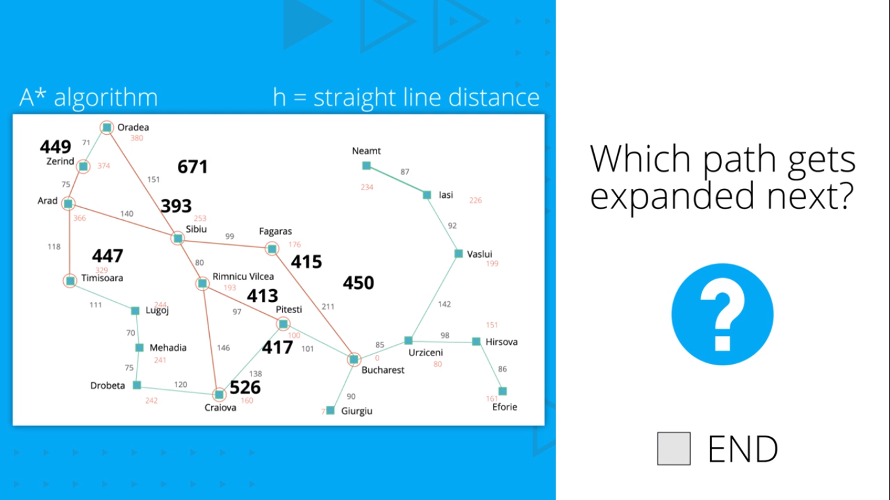

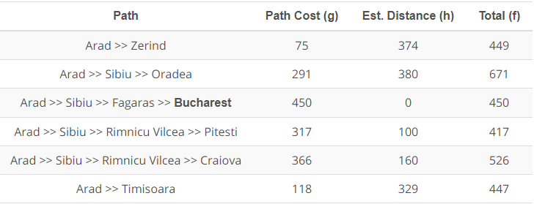

Slide 31
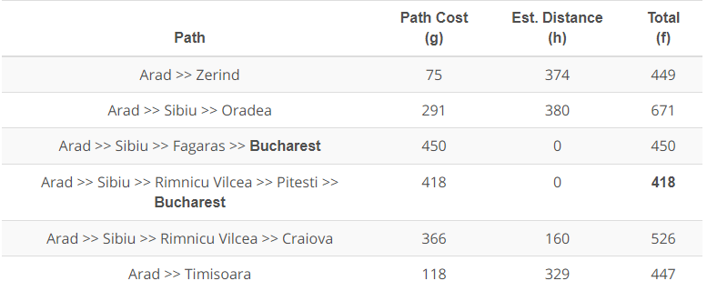
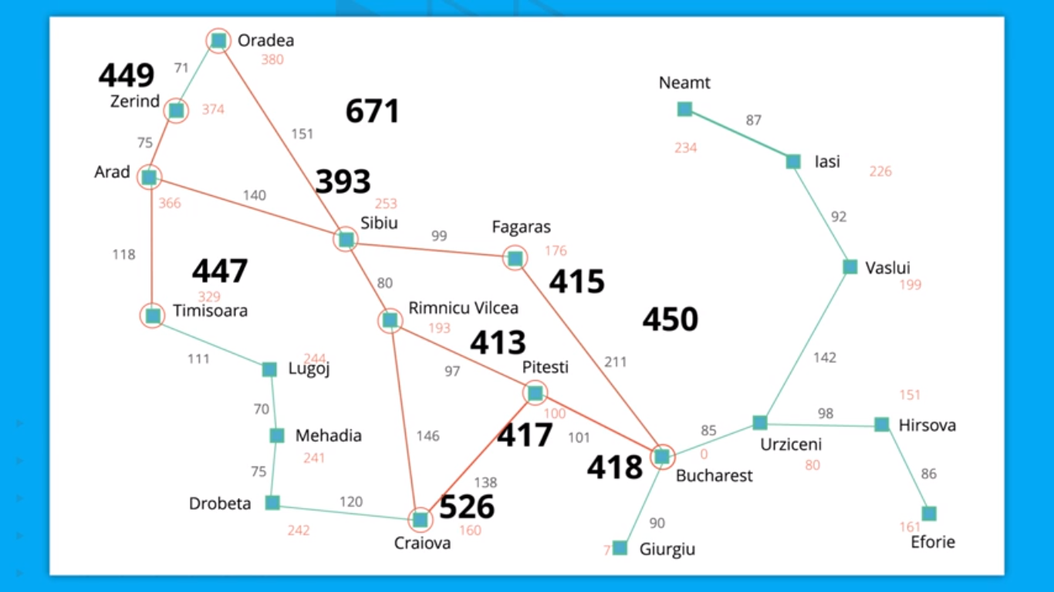

Slide 32
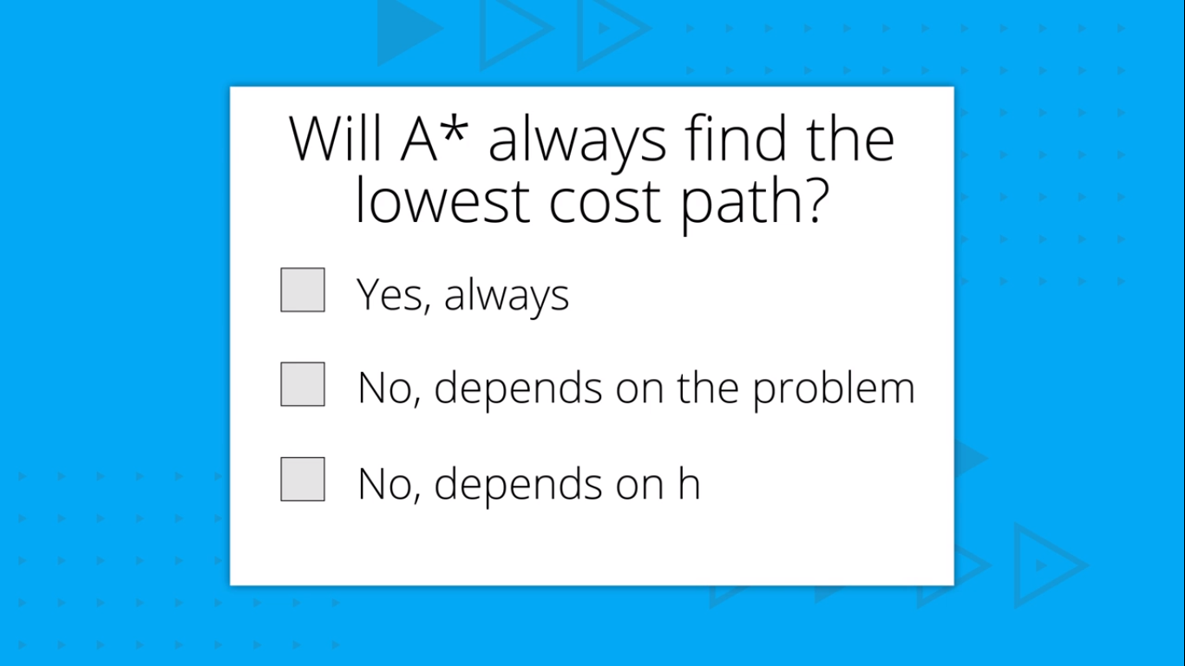

Slide 33
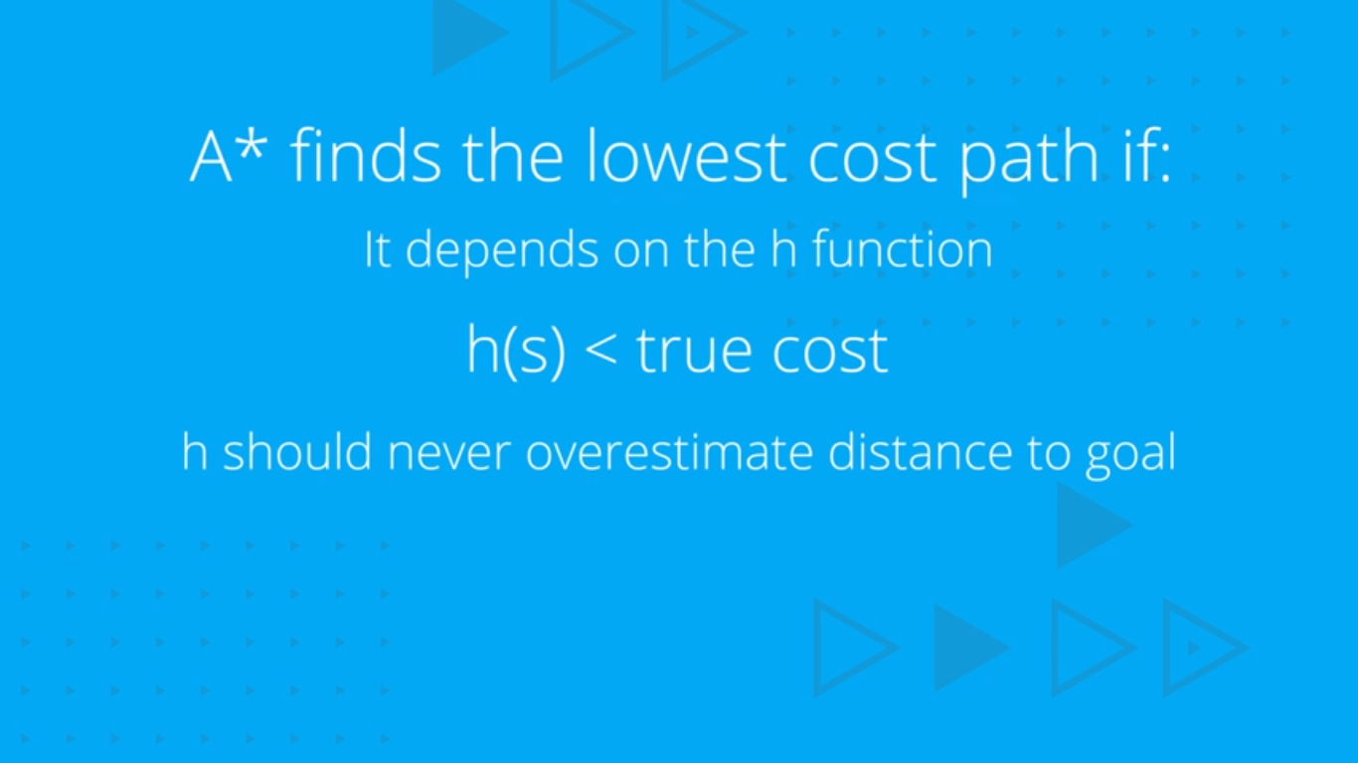

Slide 34

CONDITIONS FOR PROBLEM SOLVING BY SEARCHING

Slide 35
Back-Up Slides

Slide 36
Priority Queue
A priority queue is a special type of queue, where the element closest to being removed is at the front of the queue.
This can be implemented using a binary heap (Example: Min heap / Max heap).

Slide 37
Min Heap
A Min Heap is a type of data structure, where each node has 2 children, such that each child node is greater than the parent node.
In this way, the root node is the lowest element in the heap.

Slide 38
Disclaimer
The content in the slides is amalgamated from web and not my own

